Slide 1
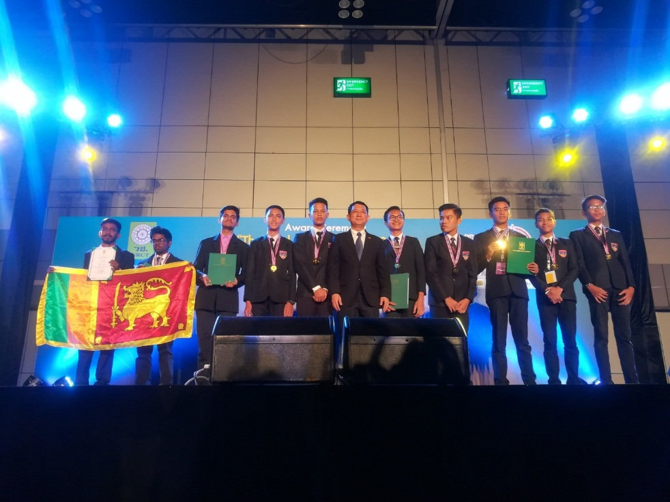
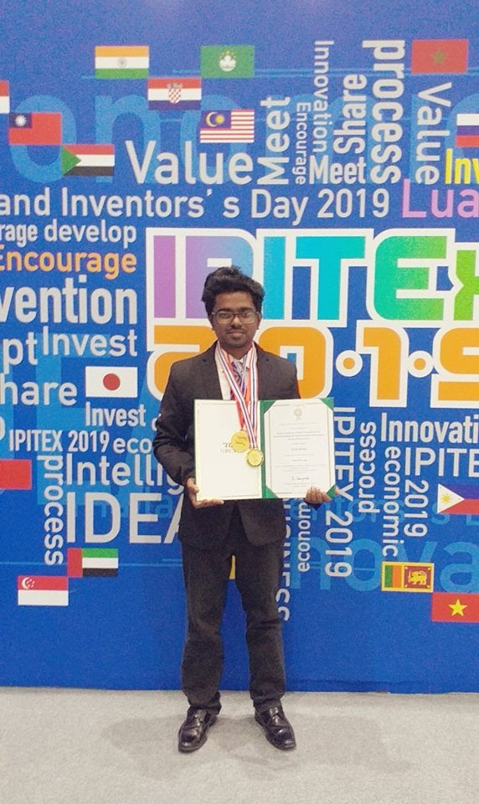
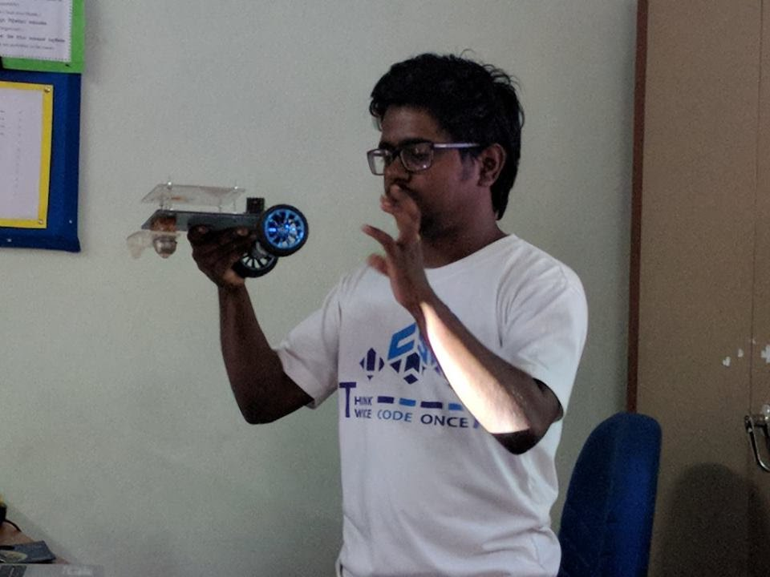
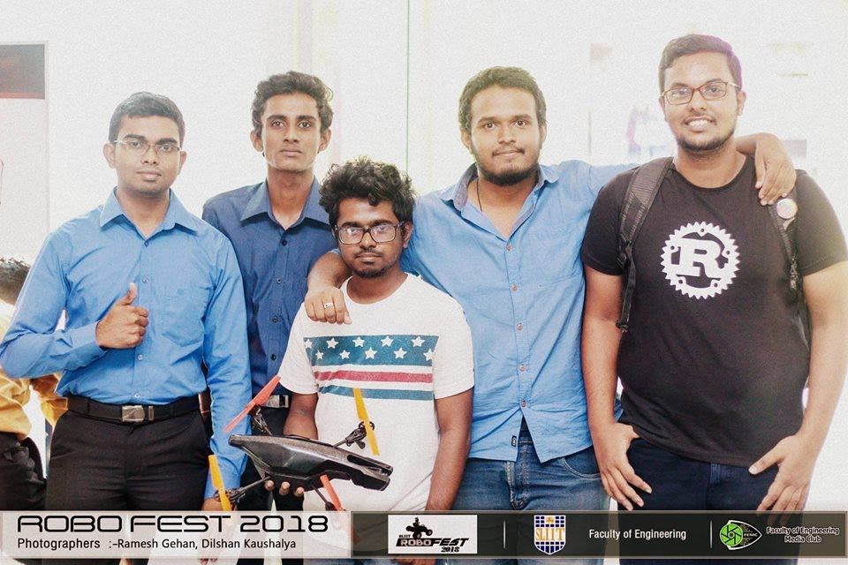
Projects Book
Buddhika P. De Silva
Department of Computer Science and Informatics, Uva Wellassa University

Slide 2
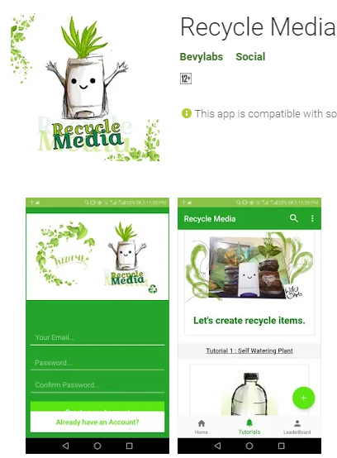
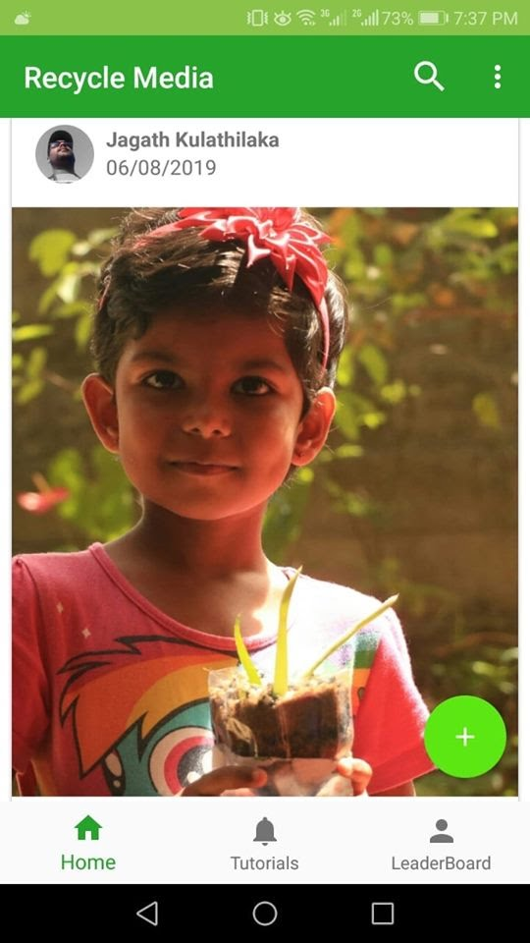

Project Name: Recycle Media App
Used Technologies : Android, Firebase , Digital Arts , HTML, Bootstrap.
Description : Social media platform for sharing creative recycle DIY projects and awareness platform for save earth from plastics.
What I learnt : Dealing with large number of data of people, Security concerns when maintaining a social media, Building a product that makes positive impact to people and the environment , Improve android development skills and digital painting skills , Creating DIY creative items using plastics Project URL :https://play.google.com/store/apps/details?id=in.tvac.bevylabs.photoblog

Slide 3
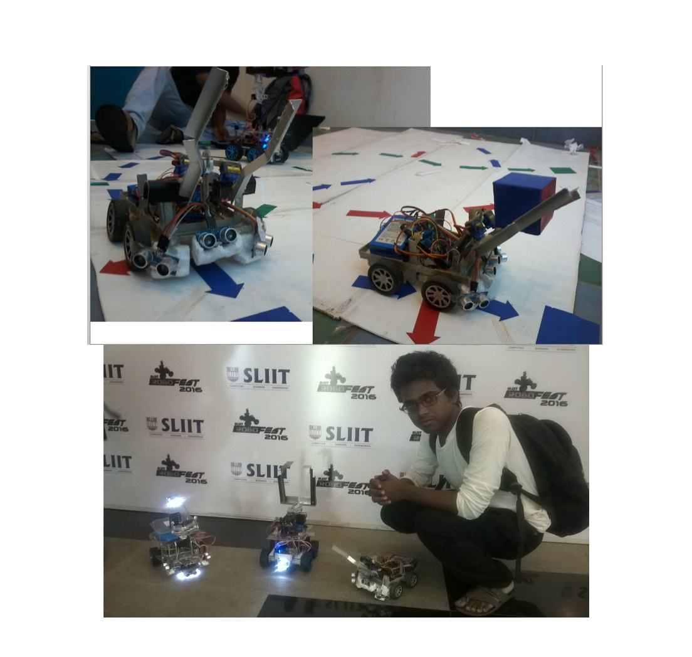
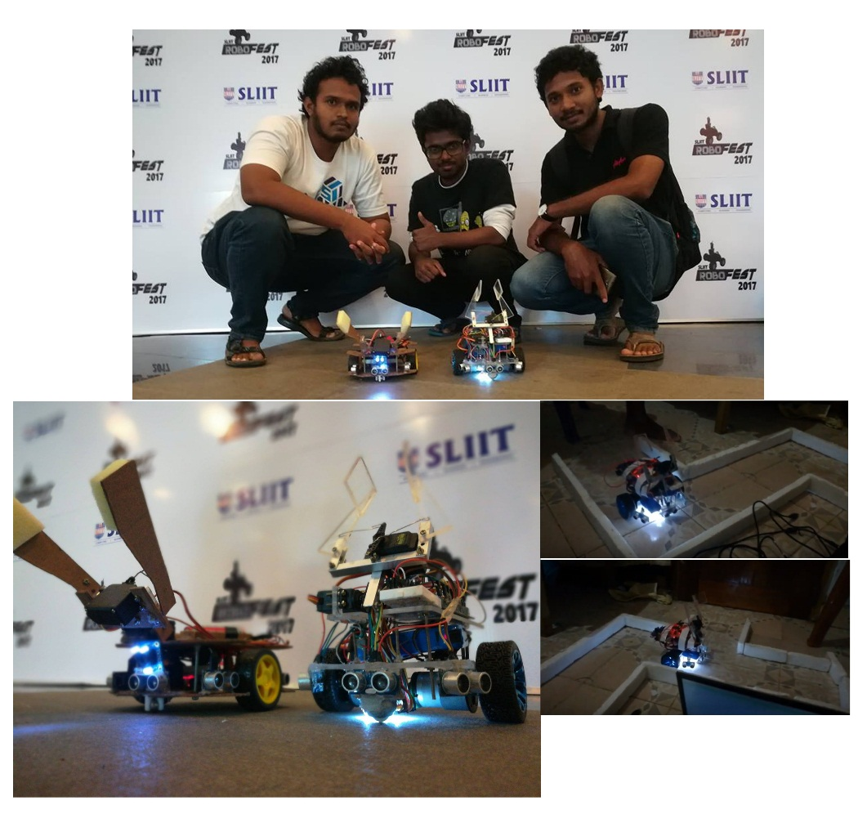
Project Name: Maze-Solving Robot
Used Technologies : Arduino , Sensors ( Color , ultrasonic ) , Maze Solving algorithms
Description : This robot is designed for grab objects with color detection , wall maze solving and going though the limited spaces.
What I learnt : Working with sensors , improved problem solving knowledge , team work , learnt to convert ideas into codes , working with limited time schedules.

Slide 4
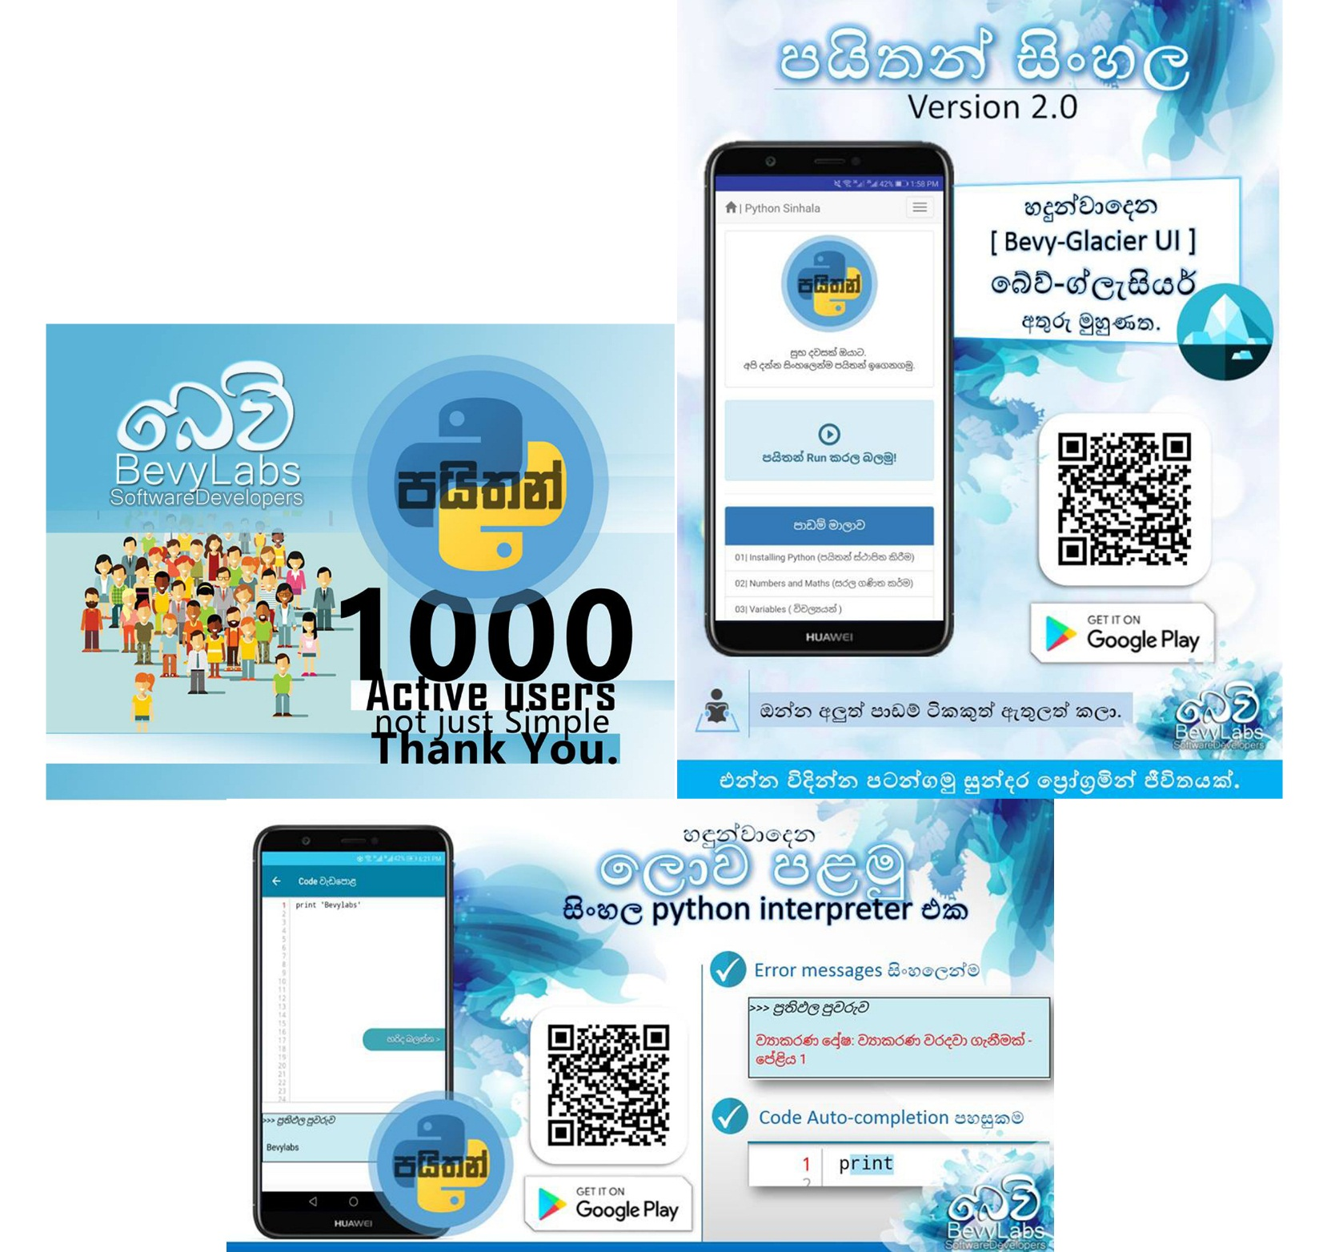
Project Name: Python Sinhala
Used Technologies: Android Studio, Java, HTML , Bootstrap
Description: An android application that helps people to startup with programming. It has over 5000 downloads through the Google Playstore.
Project URL : play.google.com/store/apps/details?id=bevylabs.buddhika.pythonsinhala What I leant : How to improve ideas ( I continuously improved eBook that I wrote in my school time into multifunctional guide to programming students), Marketing a product , UI designing , tutorial planning.

Slide 5
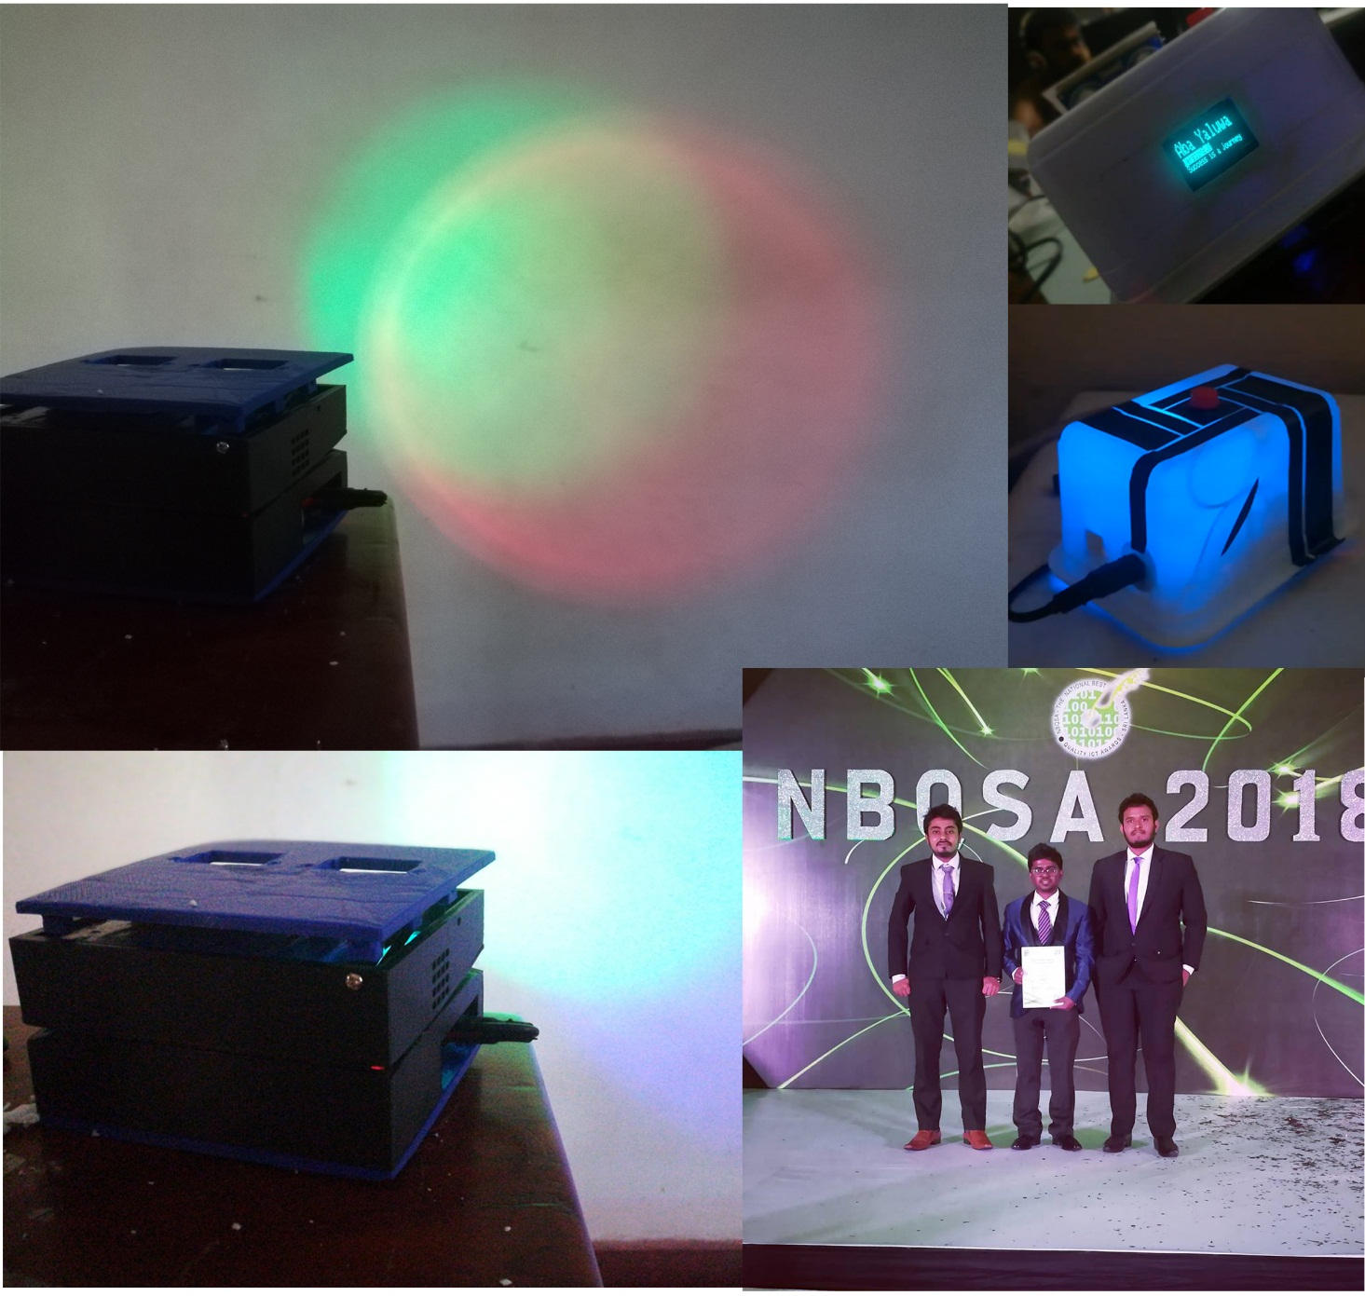
Project Name: “Amba Yaluwa” – The Concentration Device
Used Technologies: Arduino ,NodeMCU, C , Electronics
Description: A concentration device that based on psychology techniques (Color psychology , Pomodoro technique)
Awards : 3rd Place ( Bronze Medal ) in Applied Science & Technology , “Sahasak Nimeum” National Exhibition and Competition 2018 An Exhibition Organized by Sri Lanka Inventors Commission.
Merit Award - National Best Quality ICT Awards (NBQSA) 2018 Organized by British Computer Society (BCS) – The Chartered Institute for IT.
Finalist IEEE SS12 MakerFair South Asian Exhibition and Competition 2018 An innovations exhibition Organized by IEEE
What I learnt : Believing the ideas ,psychology techniques, prototyping, improving the version of an hardware project , 3D printing , working with interrupts in micro controllers.

Slide 6
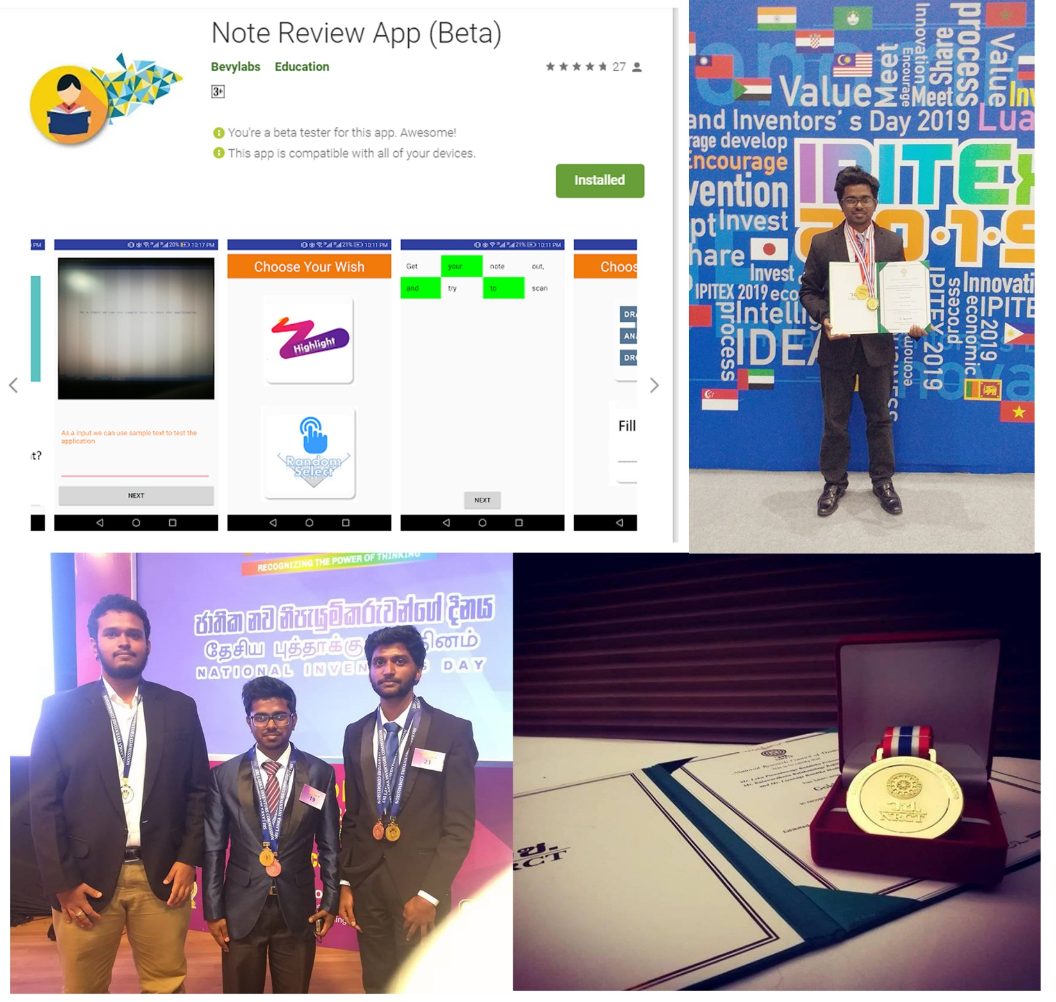
Project Name: NoteReview App
Used Technologies: Android Studio, Java, Google Vision API
Description: A solution for review notes and can evaluate the user in less than in 2mins.
Awards : Gold Medal - IPITEx 2019 (International Exhibition and Competition ) ,Bangkok International Intellectual Property Invention, Innovation and Technology Exposition. And a Special award from Indian Innovators Association 1st Place ( Gold Medal ) in ICT Category “Sahasak Nimeum” National Exhibition and Competition 2018 An Exhibition Organized by Sri Lanka Inventors Commission Project URL : play.google.com/store/apps/details?id=com.bevylabs.buddhika.notereview
What I learnt : Working with a team to achieve a goal. Convert ideas into code. Inspire others , 1st experience with android development / Google vision Api , Improving UI and UX in products , presentation skills , working with highly tied schedules, Gifts are impact for the people very much , Represent in an international competition as a Sri Lankan .

Slide 7
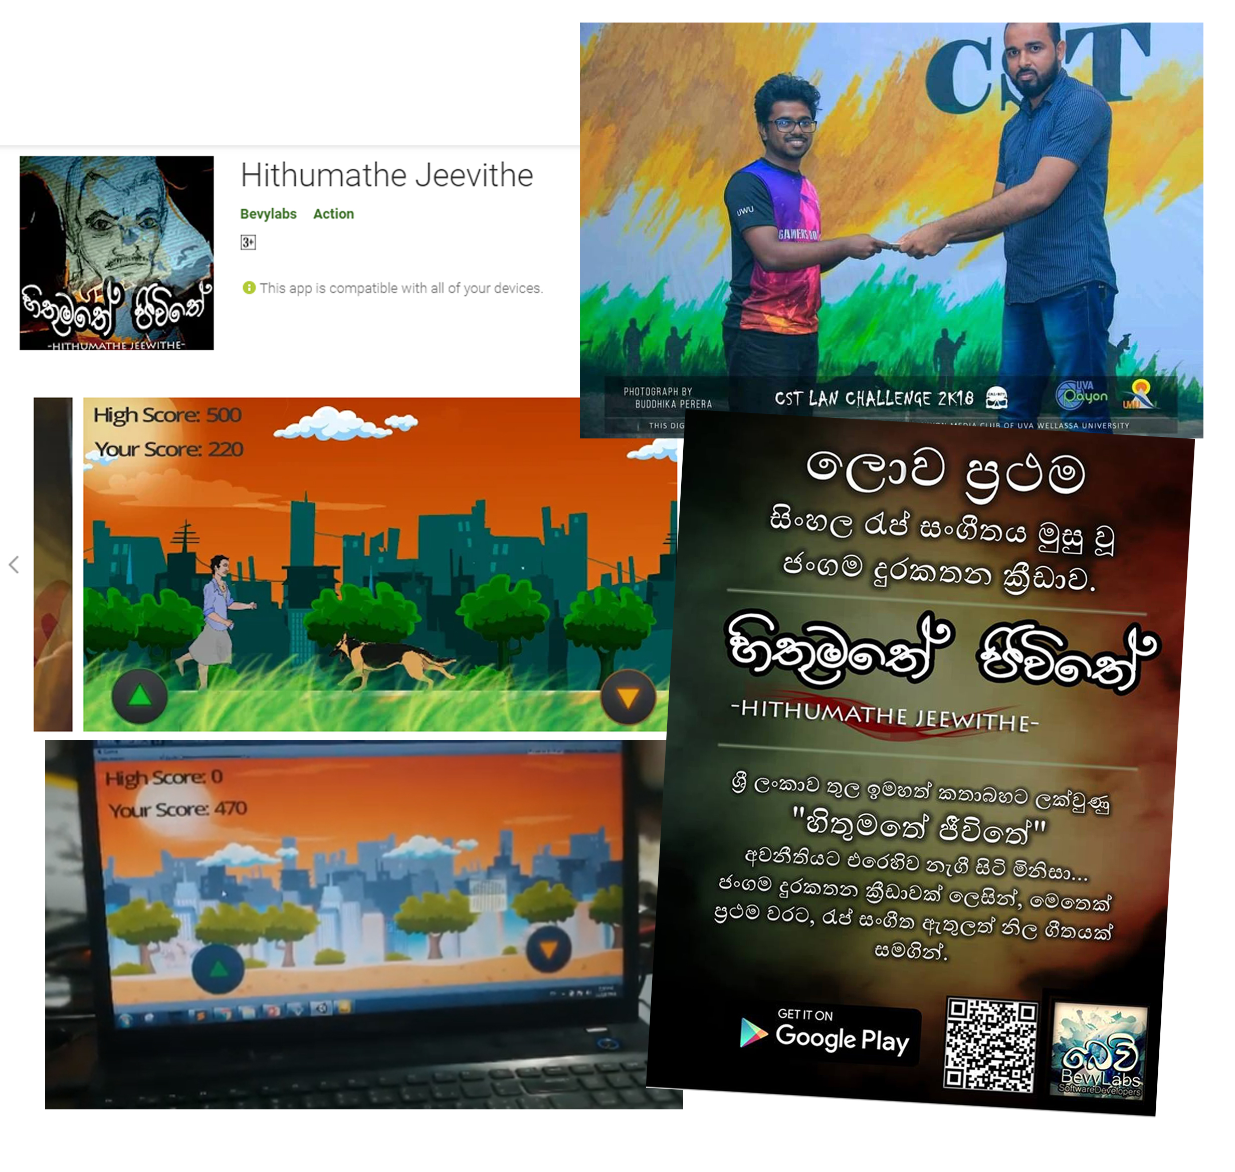
Project Name: Hithumathe Jeevithe – The Android Game
Used Technologies: Unity, Adobe PS, Autodesk SB, FL-Studio.
Description: Sri Lanka’s first game with a rap music. A platformer action game.
Project URL :play.google.com/store/apps/details?id=com.BevyLabs.Hethumathe
Awards : 1st place UWU Game Jam 2018 , A Game Hackathon Organized by Mozilla Campus Club - UWU.
What I learnt : To inspire others and get their skills on the stage , working with Unity engine , creative thinking, drawing , connecting the people.

Slide 8
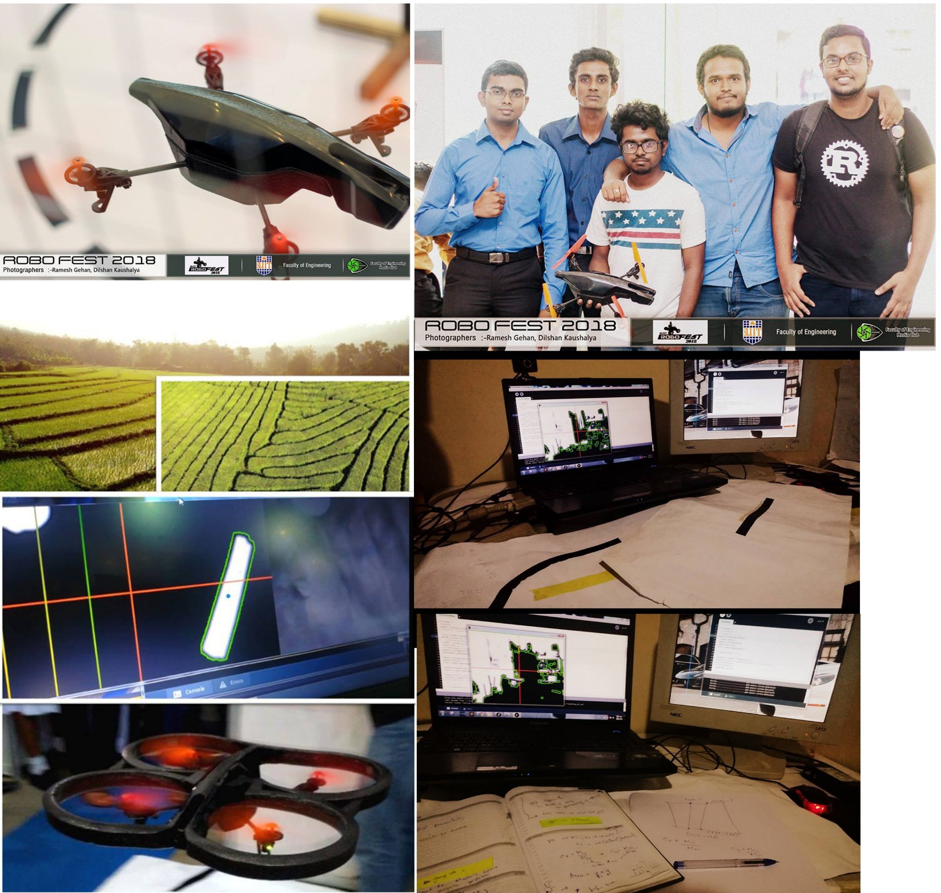
Project Name: “BevyLabsFlyBee”
Used Technologies: Linux kernel, Python, OpenCV, Processing
Description: An autonomous drone that can fly using detecting lines.
What I learnt : Improved dedicated mindset for achieve goals. Feels like as an scientist when planning the algorithms / doing calculations on papers / convert ideas into codes, improved team working skills , Had fun with the drone and got some risks when it fly , improved demonstration skills when it explanning in exhibitions.

Slide 9
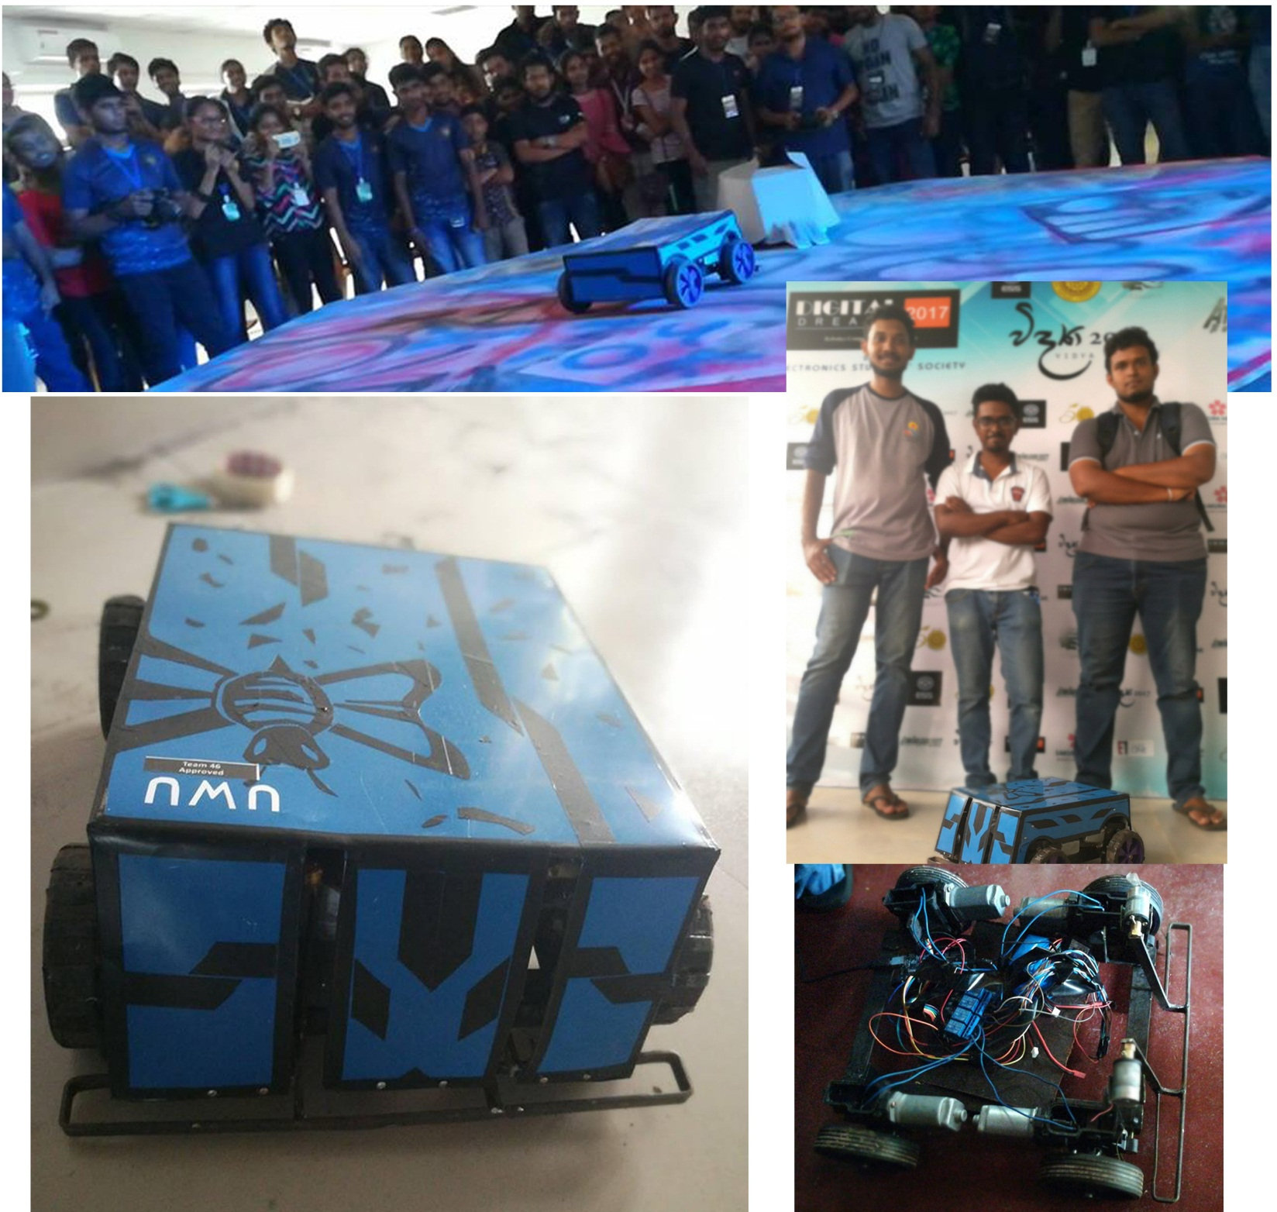
Project Name: BeeBattleBot
Used Technologies : Arduino , heavy motor controlling , working with remote controllers
Description : Battle robot that can push heavy weight and damage opponents.
What I learnt :Experience with heavy motors , improved critical thinking , team work skills , Creative designing.

Slide 10
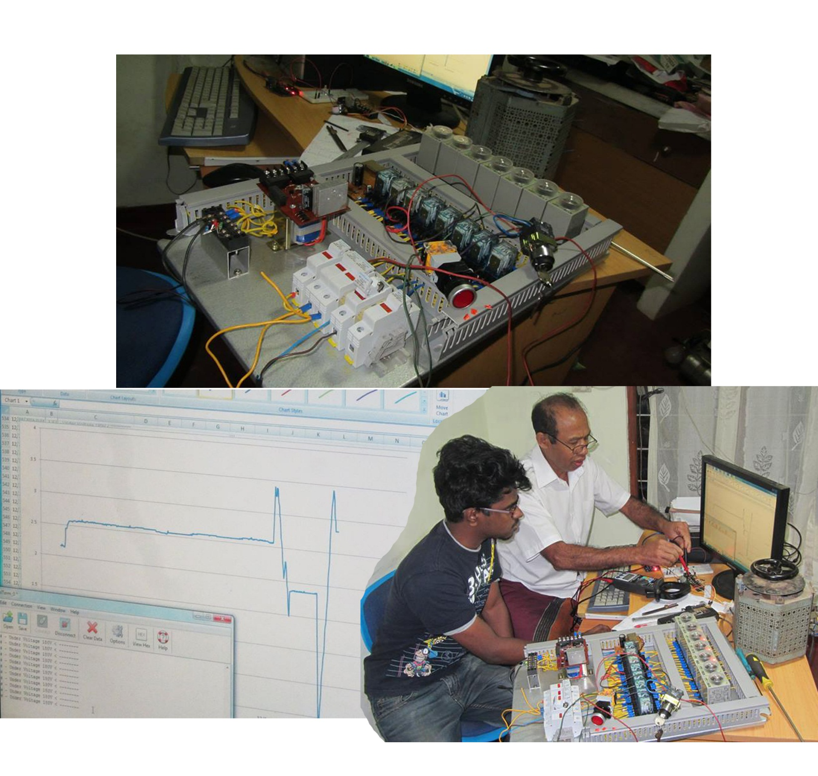
Project Name: Project “GenACMS”
Used Technologies: Arduino, C, Electronics, MS Excel.
Description: A solution for measuring/indicating A/C voltages levels with real-time monitoring system.
What I learnt : Worked with a professional , learnt about industrial equipments, Data visualization , how to solve real world problems using programming,

Slide 11
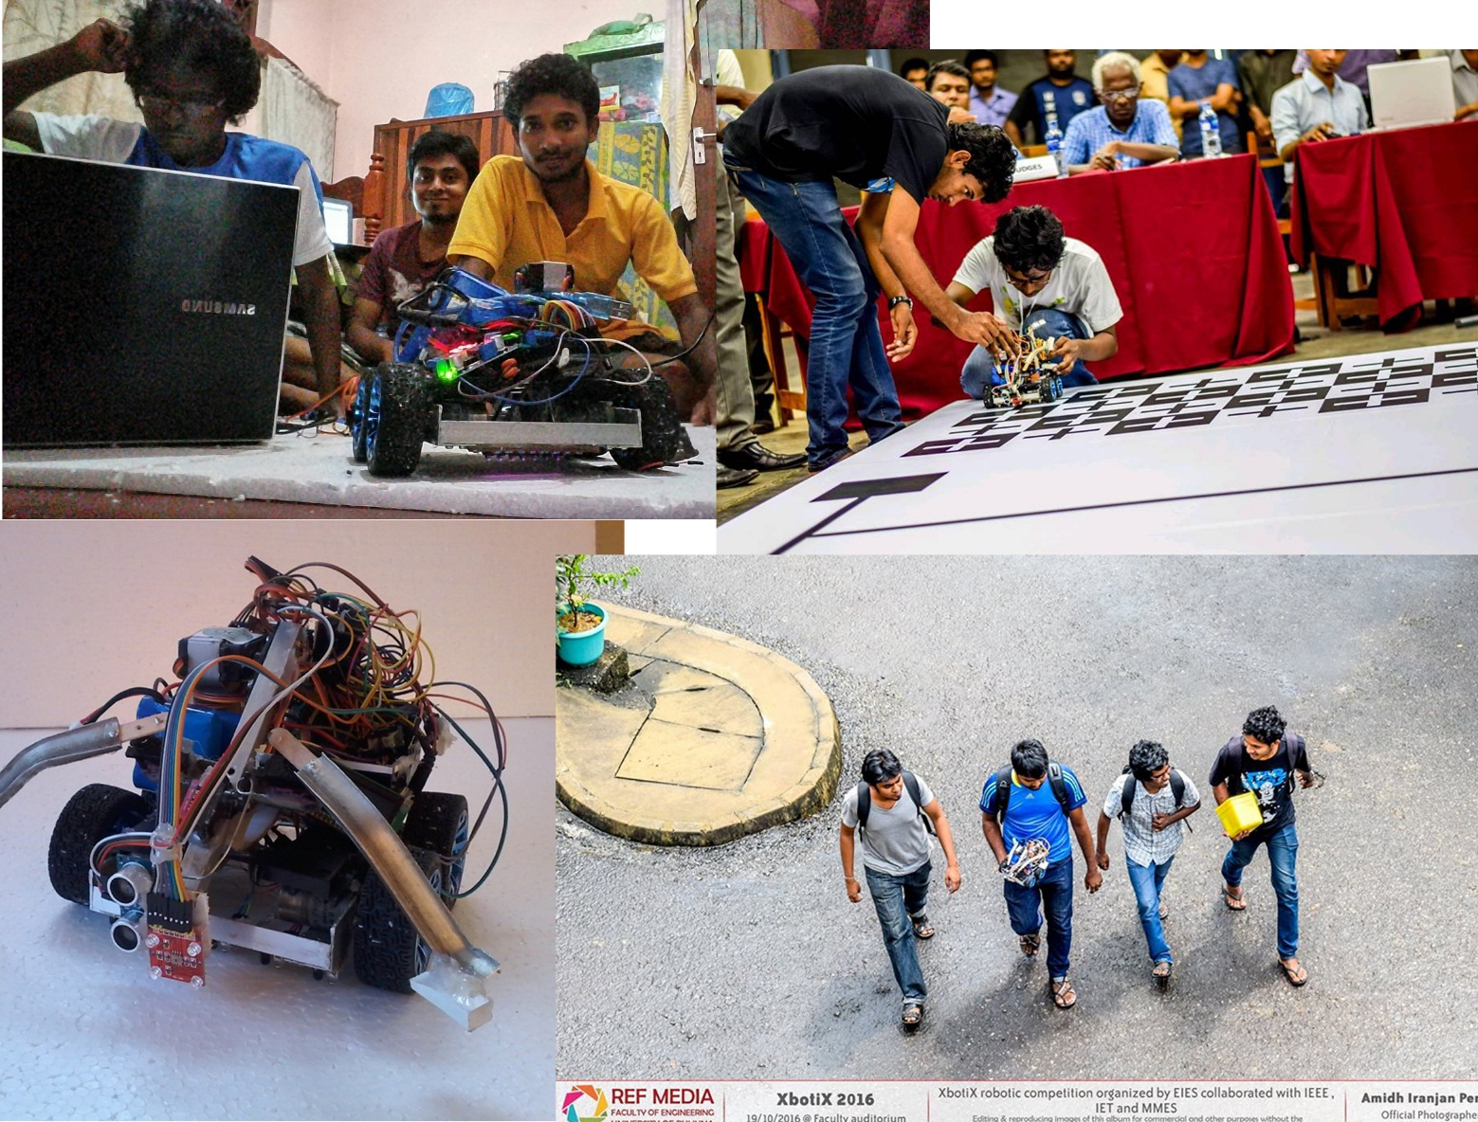
Project Name: Robot SilverTips
Used Technologies : Arduino , Sensors ( Color , ultrasonic , IR)
Description : This robot is designed for grab objects with color detection , line maze solving and going though the limited spaces.
What I learnt : Working with sensors , improved problem solving knowledge , team work , learnt to convert ideas into codes , working with limited time schedules.
Awards : 5th place of Xboticx 2016 A task based Robotics Competition organized by Faculty of Engineering, University of Ruhuna.

Slide 12
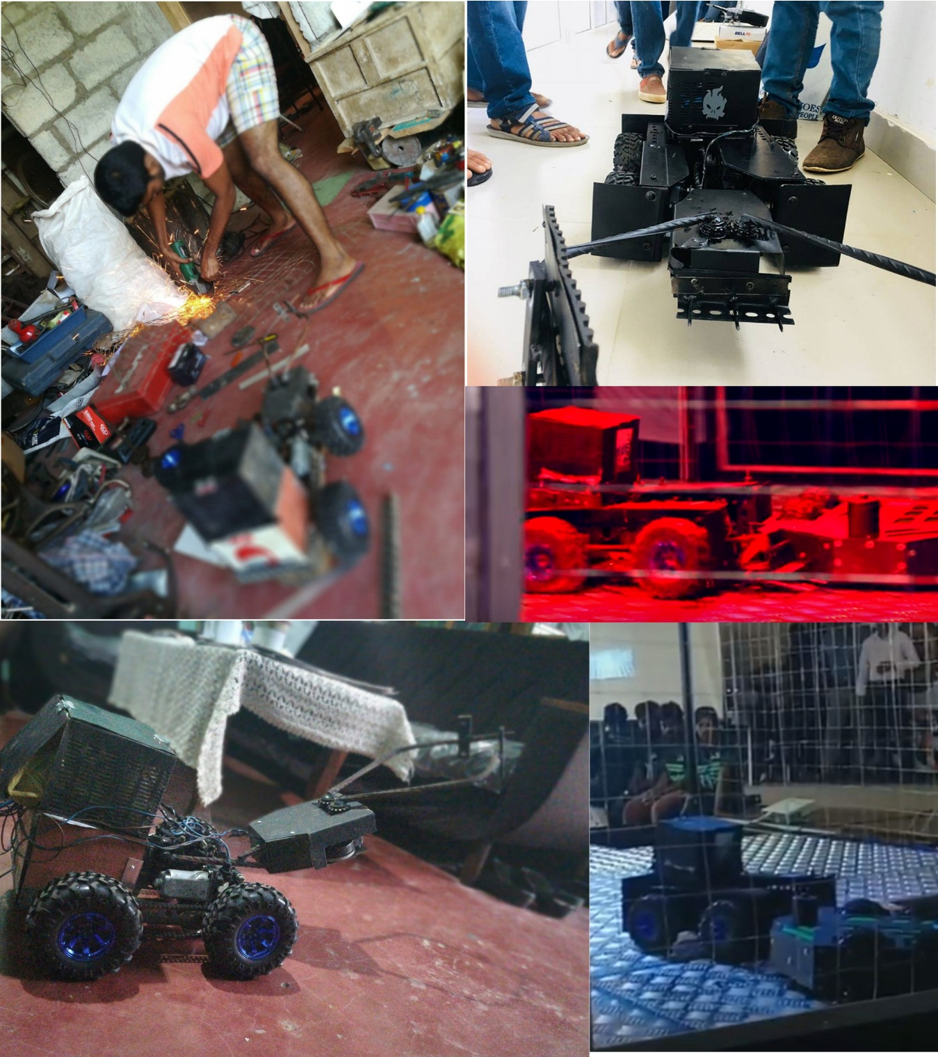
Project Name: Blacky
Used Technologies : Arduino , heavy motor controlling , working with remote controllers
Description : Battle robot that can push heavy weight and damage opponents.
What I learnt :Experience with heavy motors , improved critical thinking , team work skills.

Slide 13
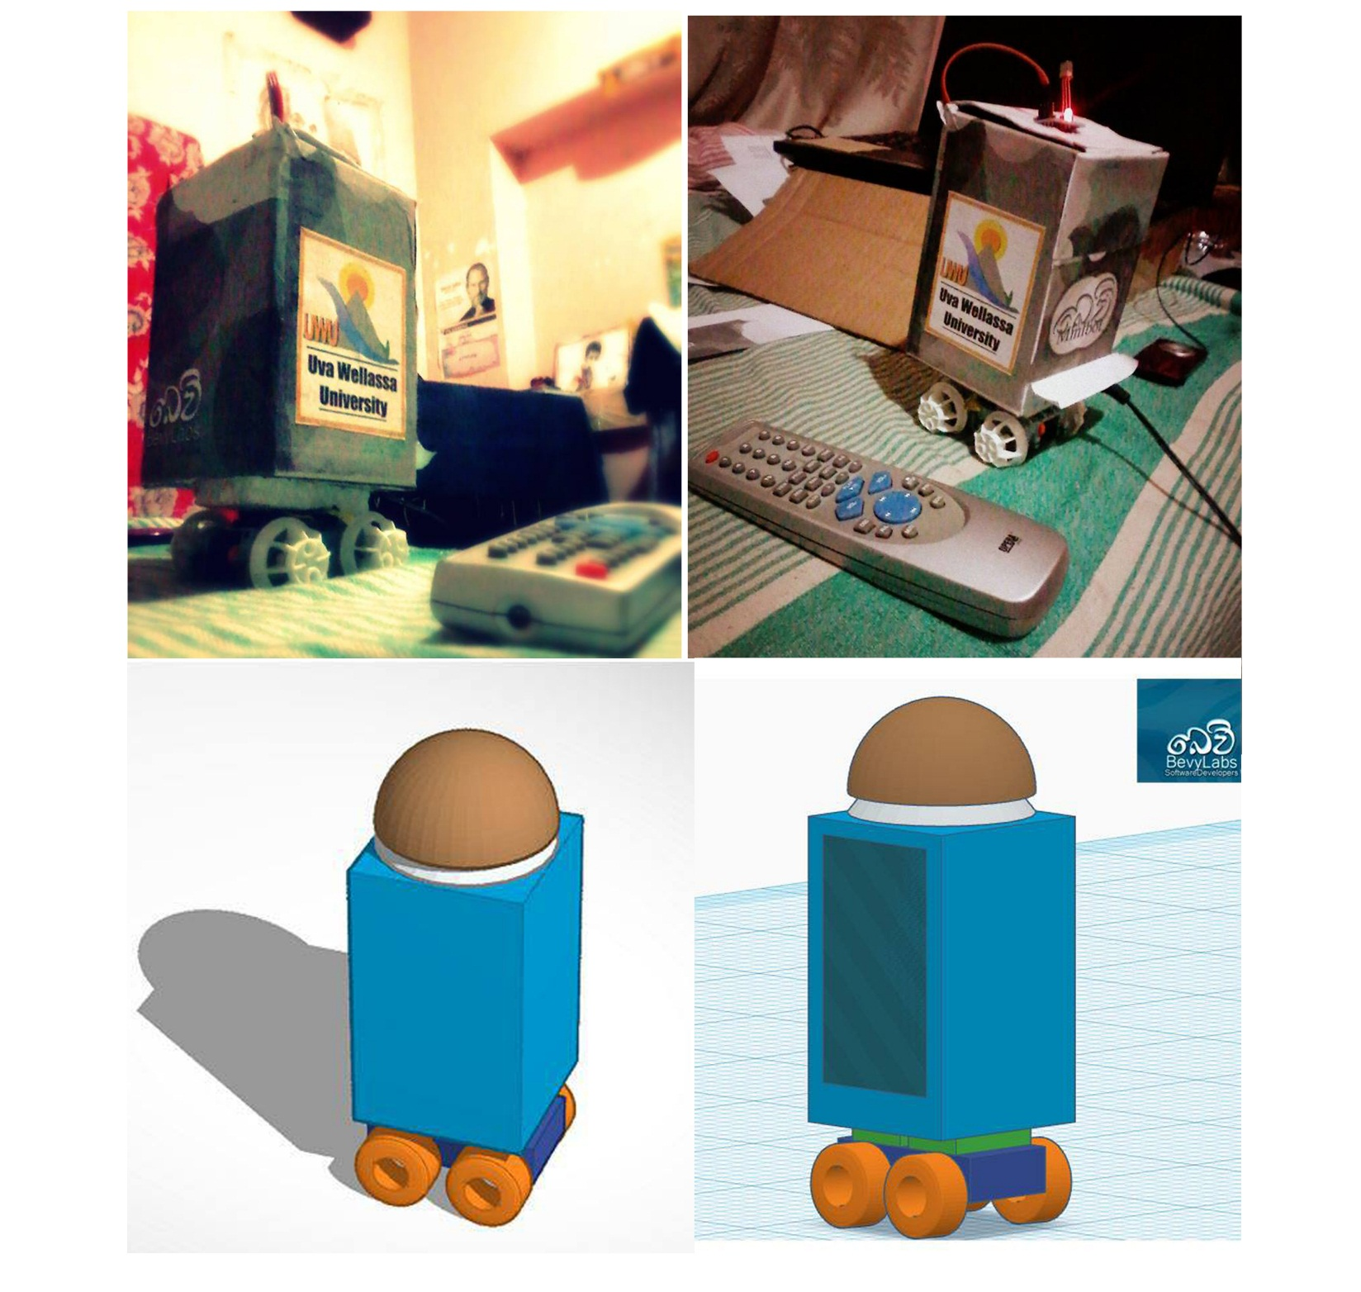
Project Name: BevyMINIbot
Used Technologies : Arduino , heavy motor controlling , working with remote controllers
Description : BevyMINIbot is a concept for a family friendly robot. He has many abilities like Holding small weight like transporting cup of tea, control with your TV remote. We are developing it as a low cost product.
What I learnt : As my first robotics project I really inspired, CAD Designing , prototyping , working with motor controlling , signal pass using IR sensors.

Slide 14
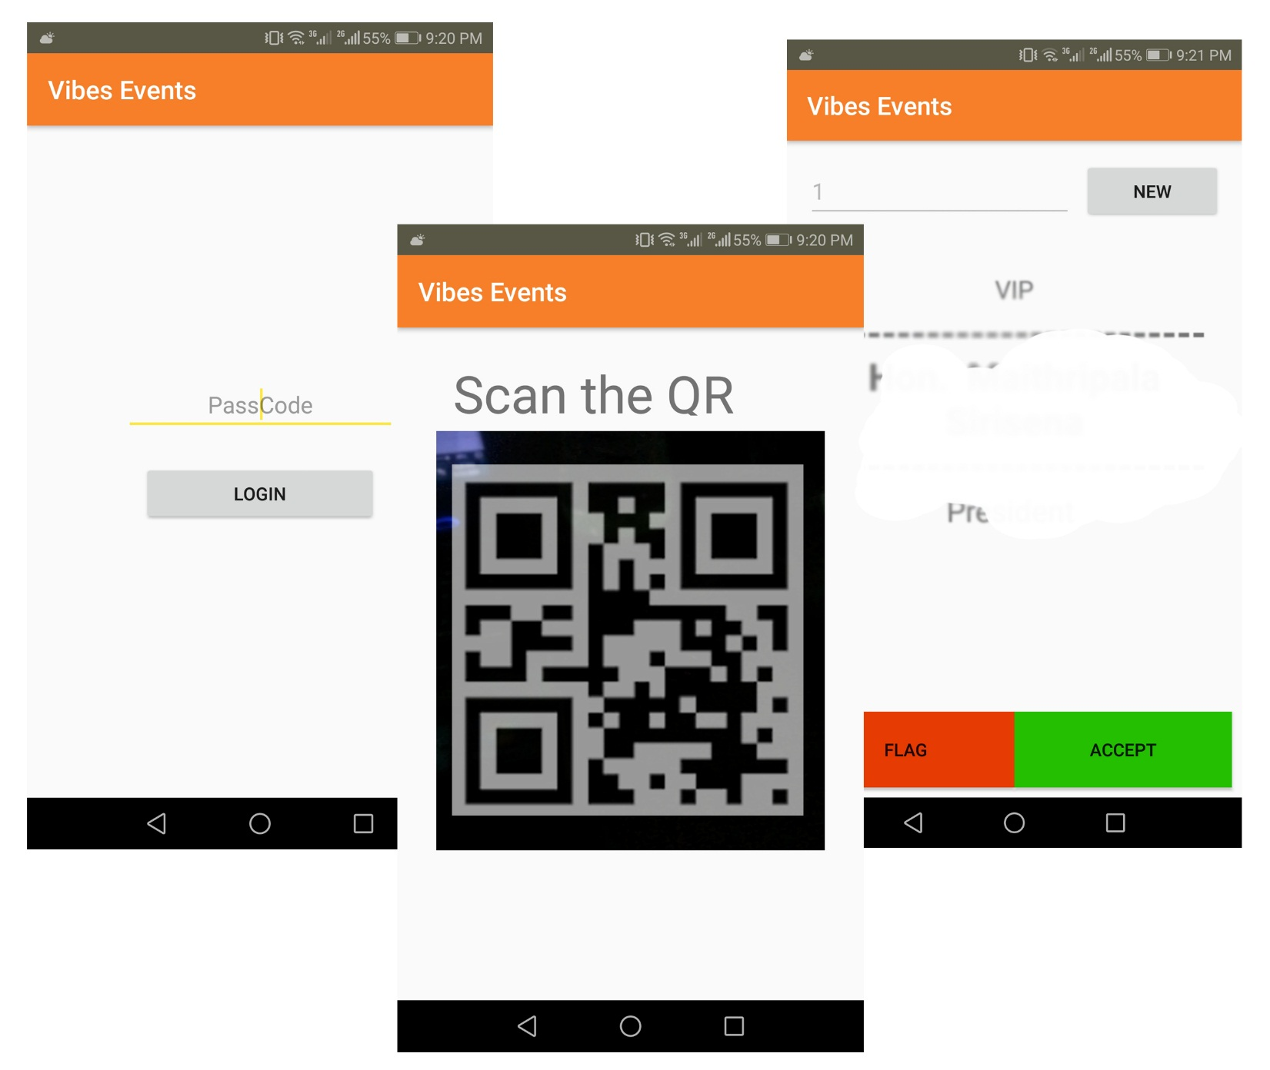
Project Name: Project “Vibes”
Used Technologies : Android, Firebase, Google Vision API, MS Excel
Description : A mobile solution for who want to mark attendance of a large number of people in less amount of time. Successfully implemented for a VIP event in Sri Lanka.
What I learnt : How I work with a highly risky project , working with realtime database like firebase, Manage time with the busy time schedule , Data pass between more than one different databases , Build more responsive application , improve the UX / UI with feedbacks

Slide 15
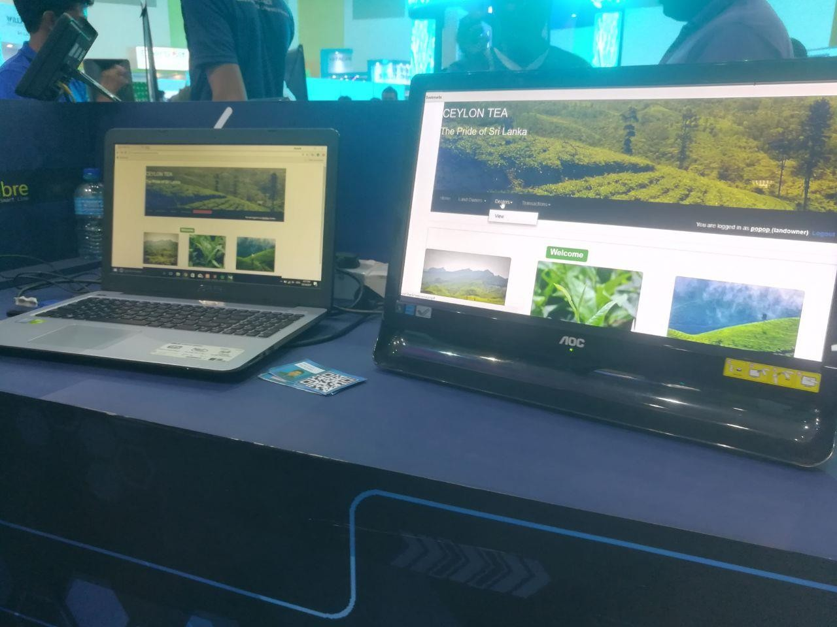
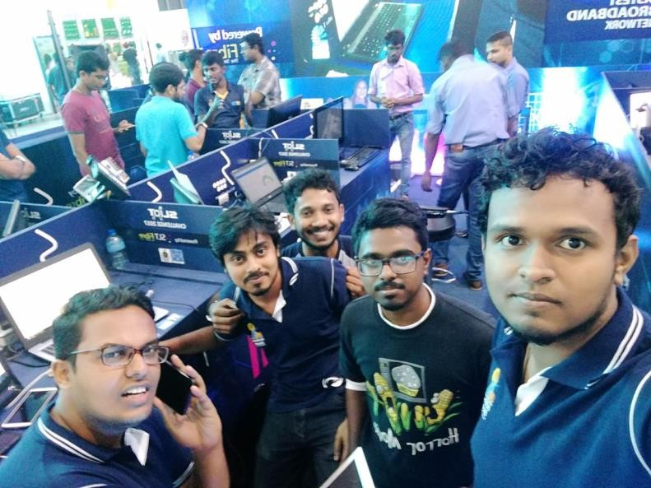
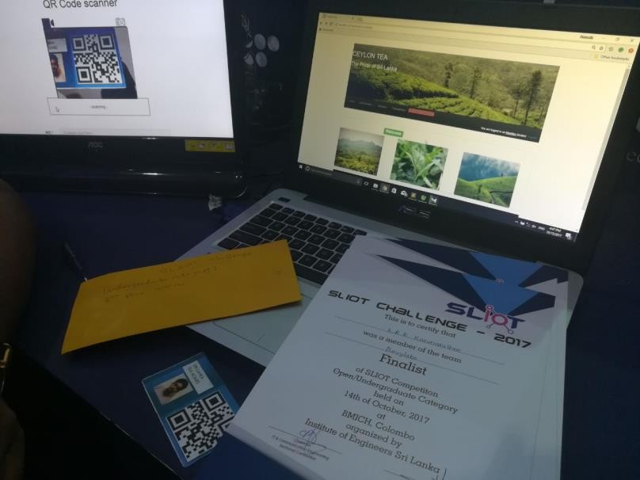
Project Name: teaCollect++
Used Technologies : Php, MySQL , QR reader
Description : New concept for tea collecting process in srilanka.This system provides various solutions for problems in manual tea collecting process.
Awards : Finalist in SLIOT Challenge 2017 / Finalist in iHack 2.0
What I learnt : Field visits to gather requirements for different user roles, Improving UIs for better user experiences that relates to different user audiences

Slide 16
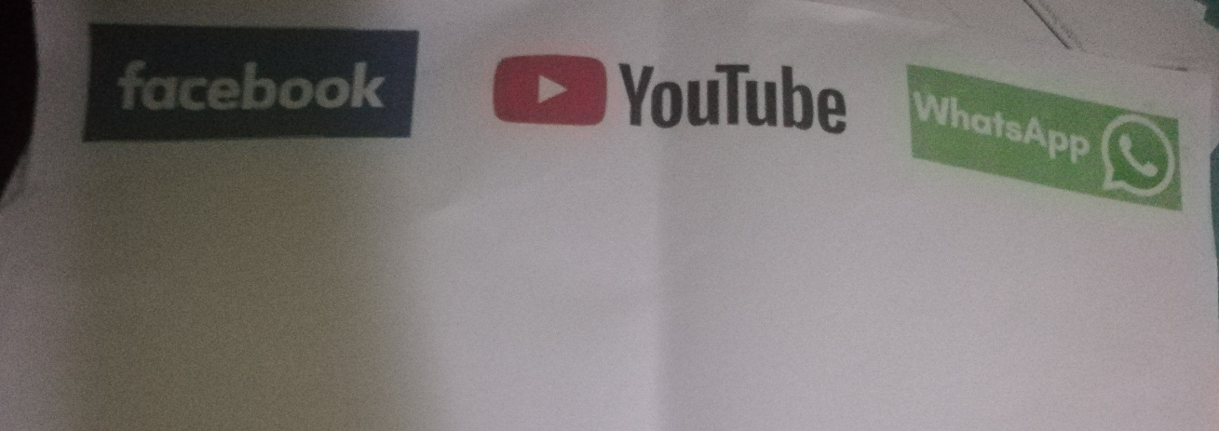
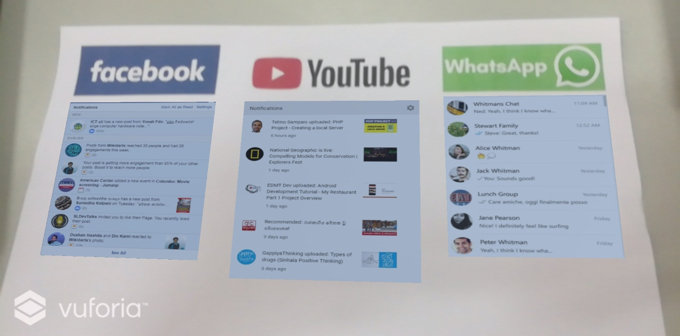
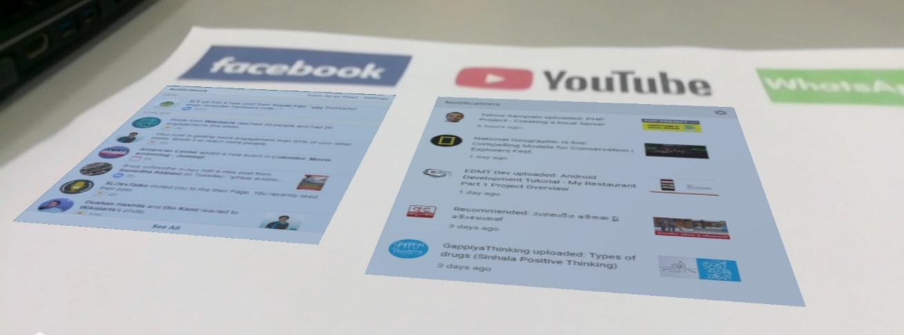
Project Name: Social Noti.
Used Technologies : Unity, Vuforia , Augmented Reality.
Description : This application can check and display social media notifications in one place with augmented Reality. As the markers I used social media icons , if camera point out to it , below that notification are appear. What I learnt : Think in different way to use AR for solve real world problems , Learnt more about Unity and Vuforia.

Slide 17
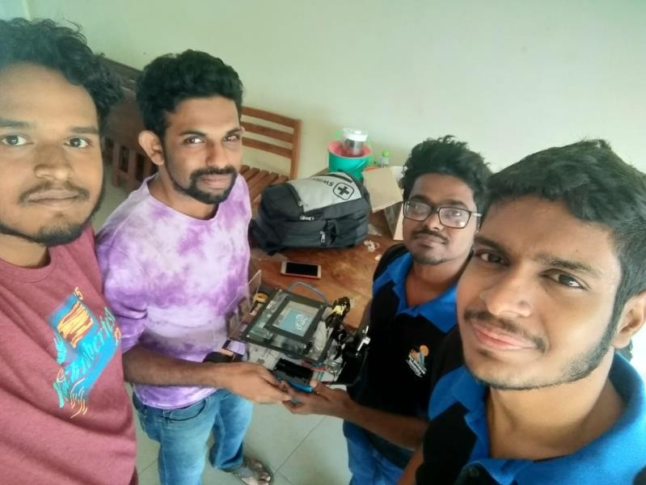
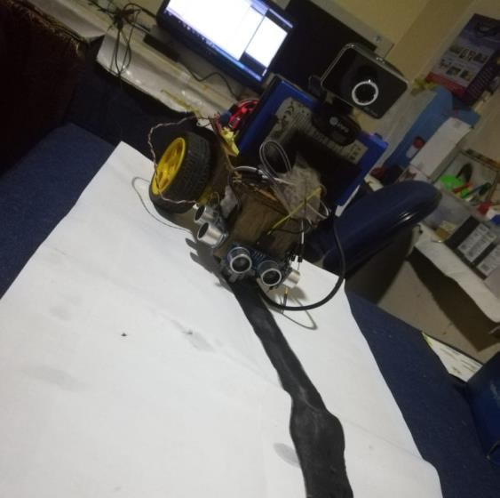
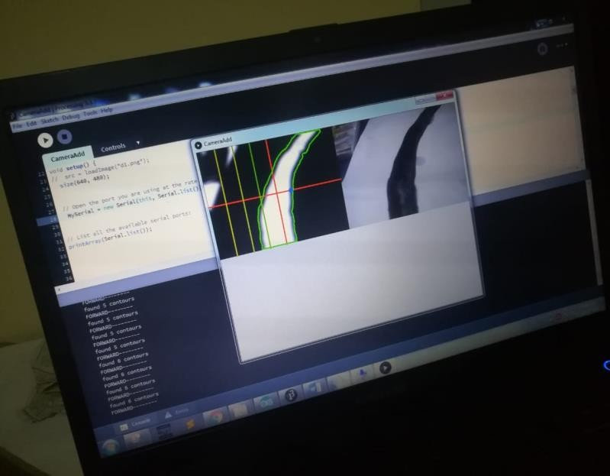
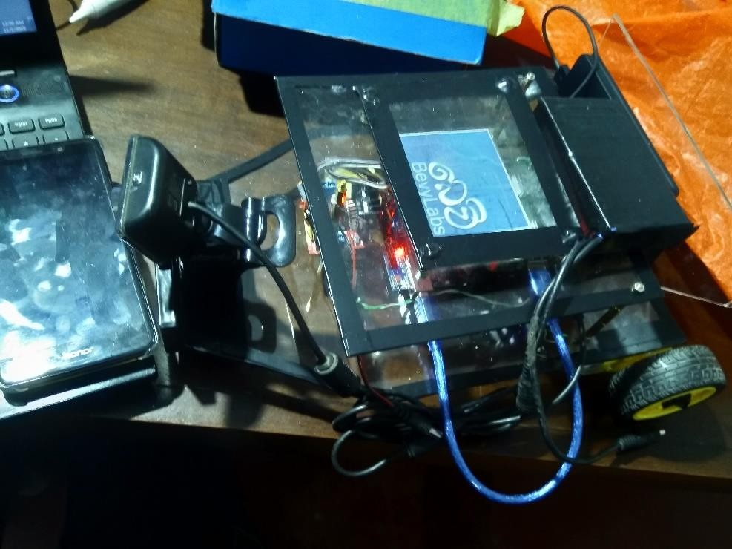
Project Name: Self Driving Car
Used Technologies : Processing , OpenCV , Arduino , motor controlling , Raspberry Pi
Description : Self driving car that can detect a line using webcamera with Image processing and controlling motors relevant to the camera inputs.
What I learn : Raspberry Pi , Serial communication between Raspberry pi and the arduino , Raspbian OS , Image processing techniques.

Slide 18
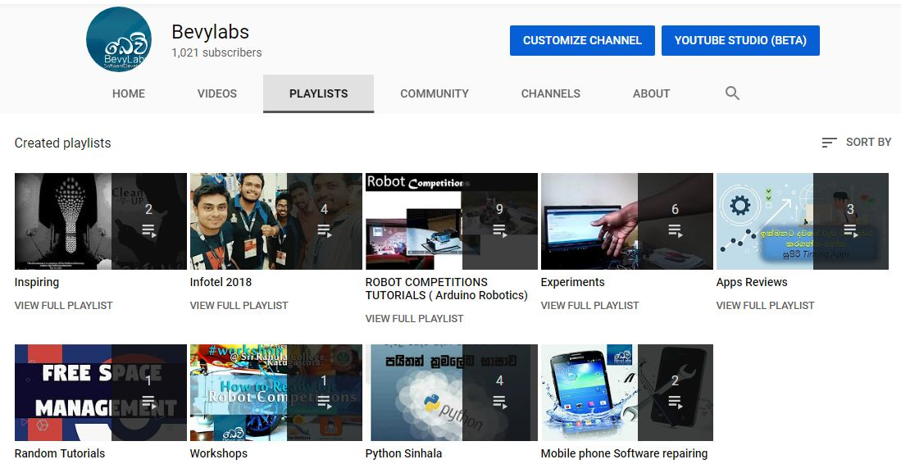
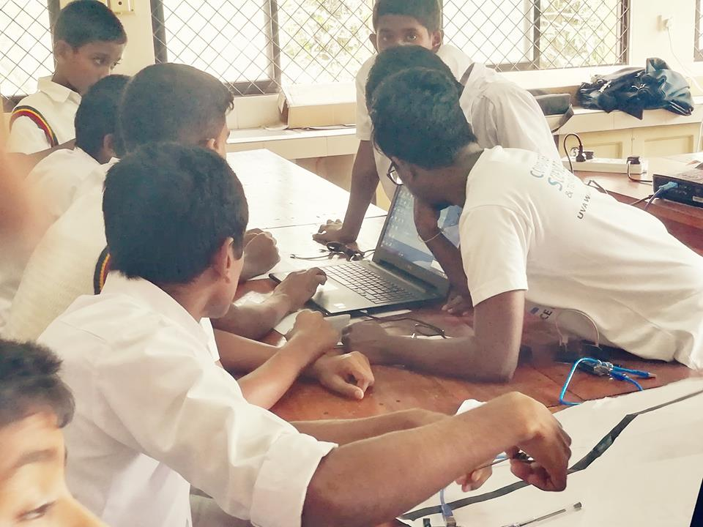
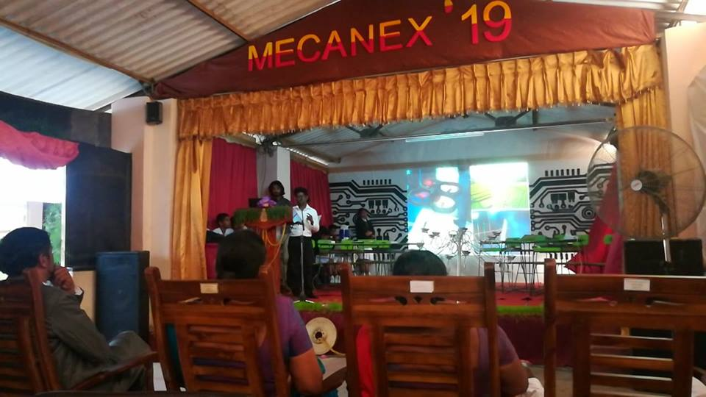
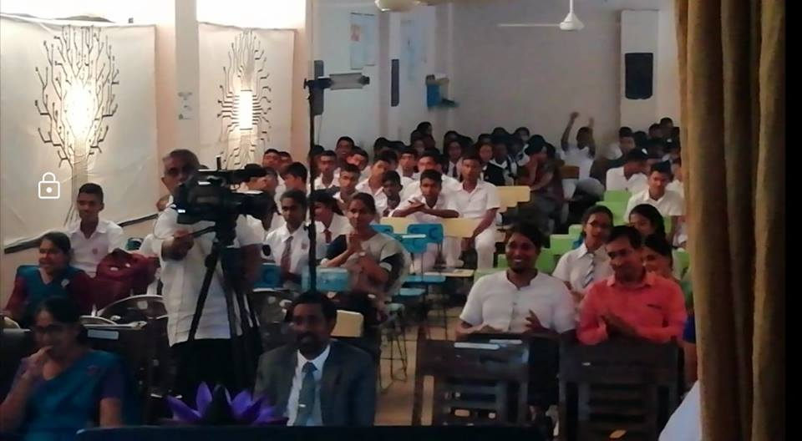
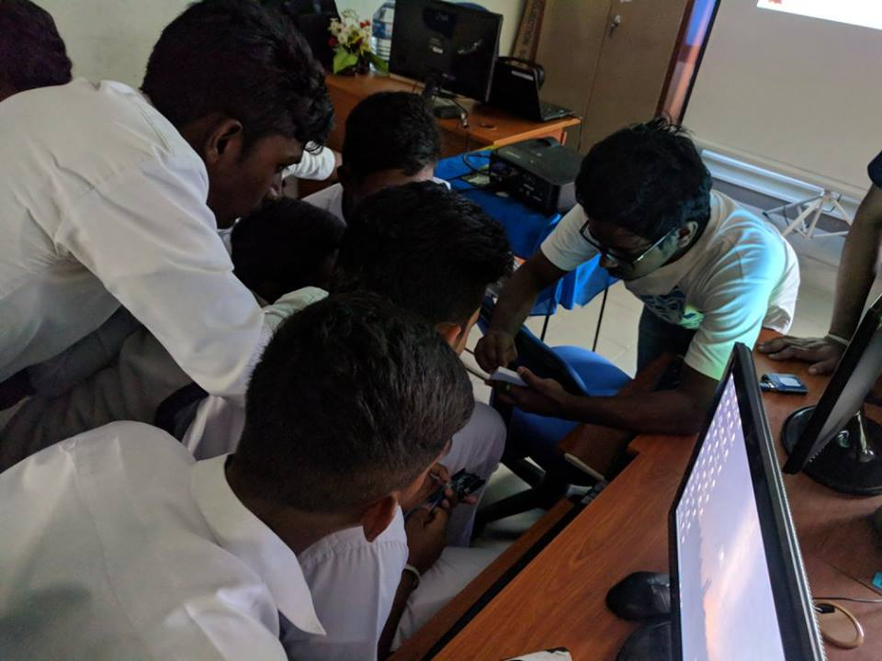
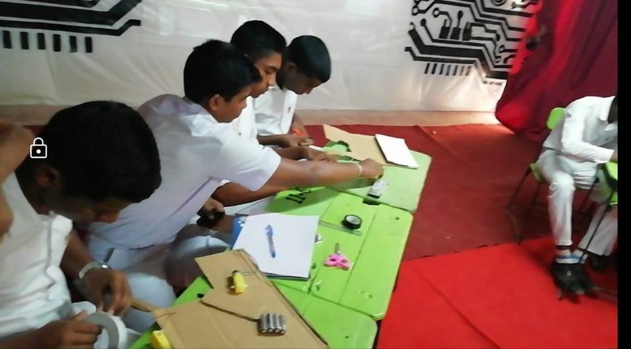
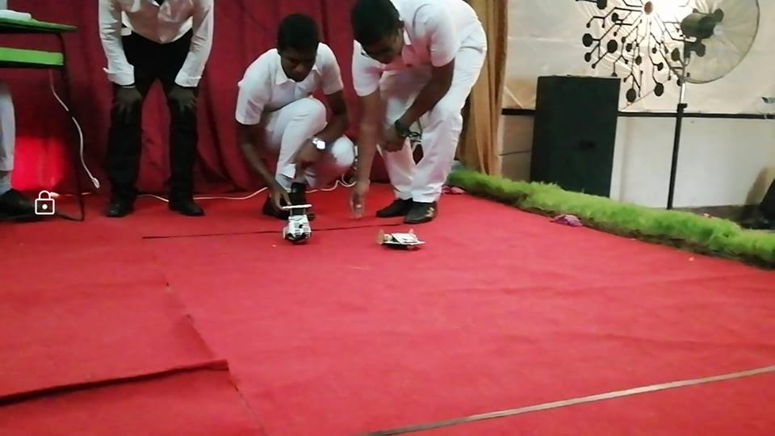
As a Youtuber / Contents Creator
I’m doing programming / Robotics / Mobile Application Tutorials on youtube. I use it as a platform to share my knowledge to the world. Recently it has over 1000 subscribers from all over the world.

Slide 19
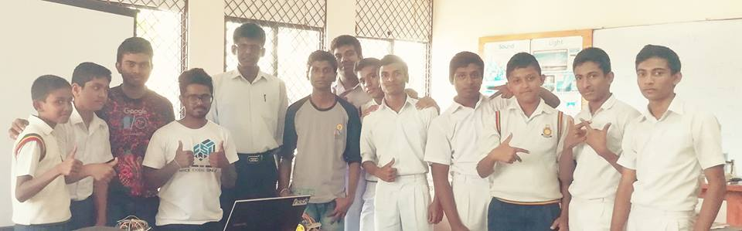
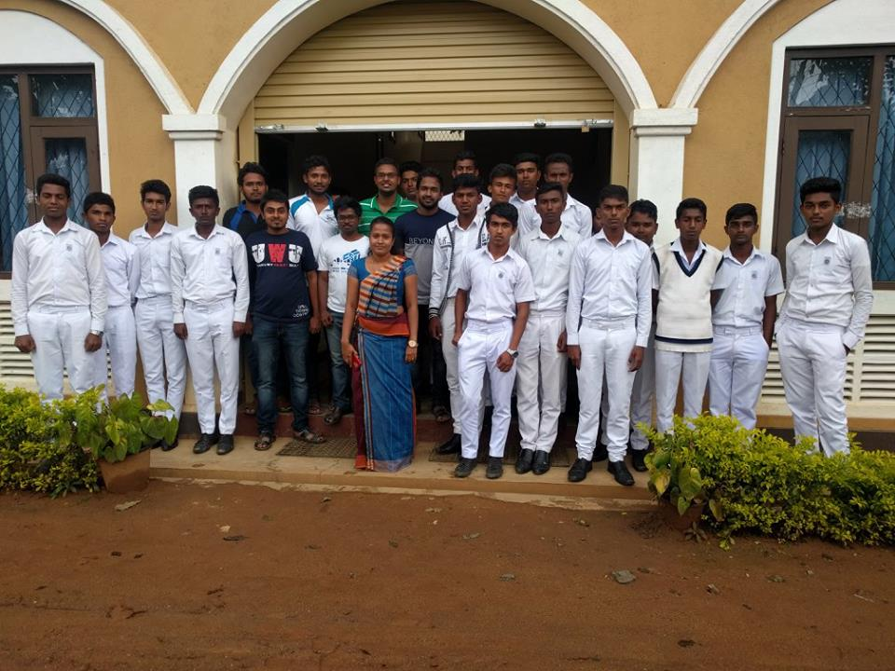
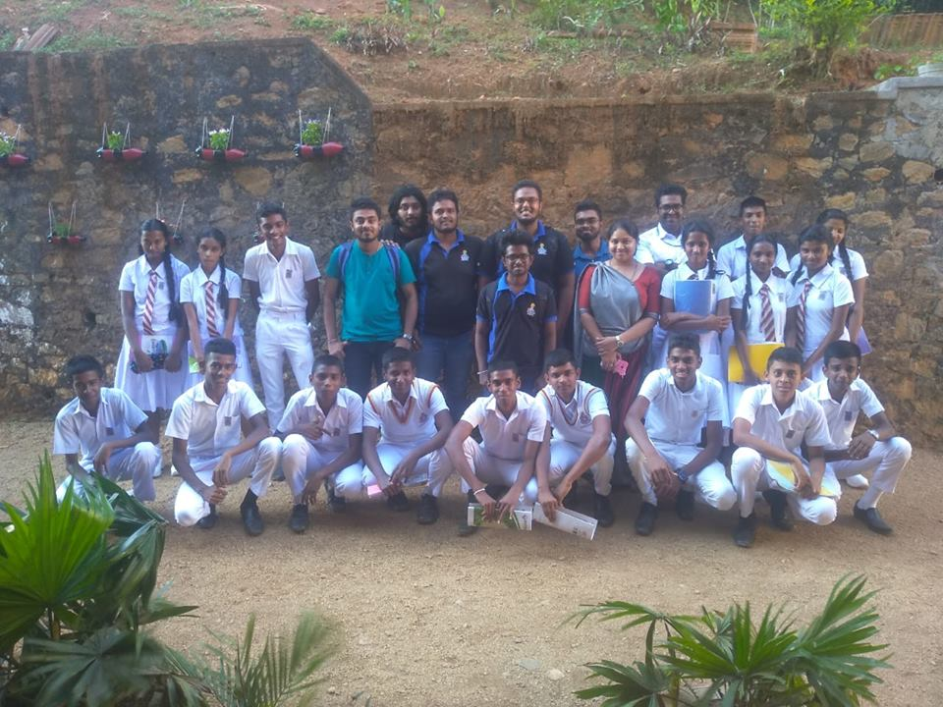
As a Resource person for workshops
I and my team conducted several workshops about how preparing for robotics competitions and some motivational sessions to inspire the students to achieve their goals. Also, we got many positive feedbacks on our workshops.

Slide 20
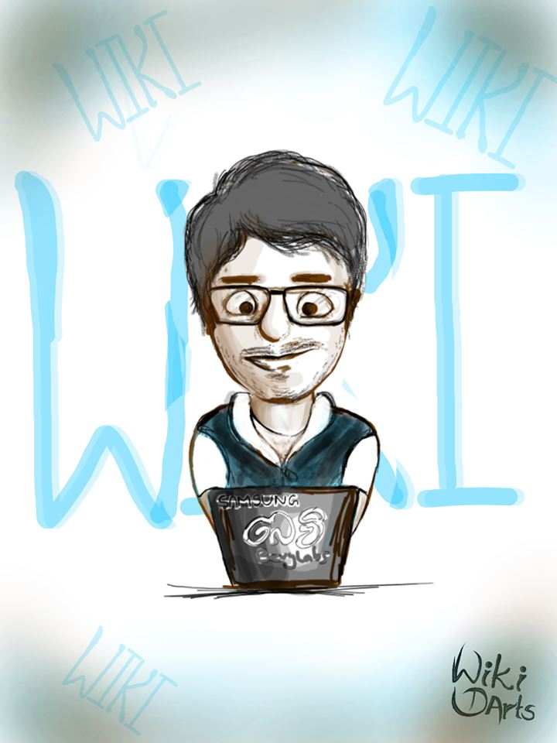

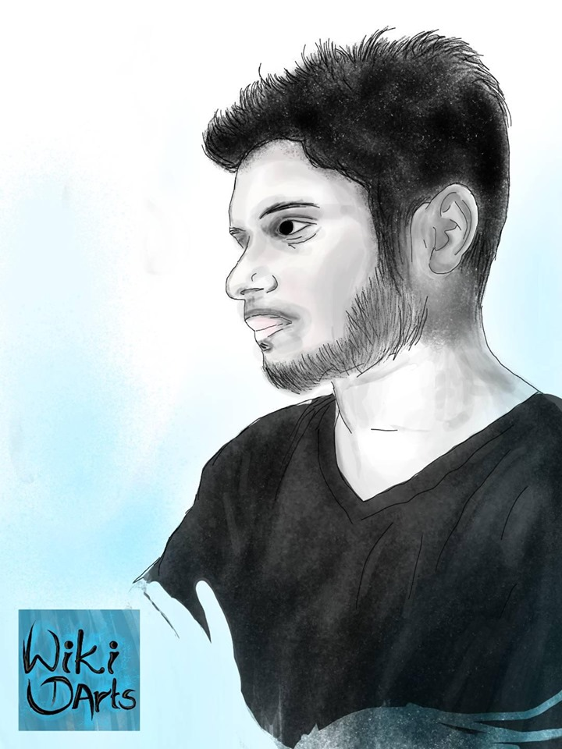
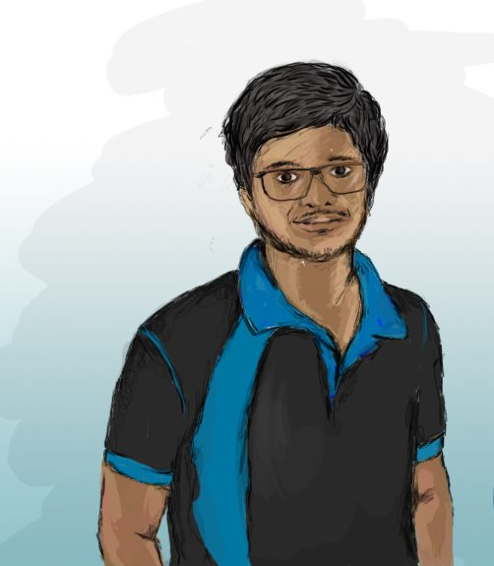
As a Digital artist / Concepts designer
Since my childhood I trying with new conceptual designs and ideas, these are some digital arts I drawn recently.

